Slide 1
LLM MODEL COMPARISON

Slide 2
model capabilities – OUR ANALYSIS
Models | Metrics/ Input Queries | Command R Plus | GPT 3.5 Turbo | GPT 4 Turbo
Metrics | Context Length | 128k | 16k | 128k
 | Quality | 80 | 67 | 100
 | Price (1M Tokens) | $6 | $0.75 | $15
Observations Based on – QnA Summarization Content Generation Translation Code Generation | Can you generate a detailed description of the mechanism of action for Vanflyta and its potential therapeutic applications? | Hallucinates a lot on topics (made up answer even when temperature is set to 1) | Some inaccurate information in the response and not very well structured | Accurate responses generated but is slow in generating the responses
 | Summarize the results of recent clinical trials investigating the efficacy and safety of vanflyta in treating cancer. | Gives incomplete answers. Meets its token limit and stops at the point or sometimes even before | Gives complete answers within the limit | Gives complete answers within the limit
 | Send an email with project plan to productionalize search AI assistant | Model provides more comprehensive answers and it structures well | Structure is similar to GPT 4 turbo but the response was more accurate | More concise responses, not as well structured
 | Translate how are you to Kannada | Did not translate correctly | Translates accurately | Translates accurately
 | Create a Python function that calculates the factorial of a given number. | Provides 1 approach; code explanation; 1 test scenario | Provides 1 approach; no code explanation; multiple test scenarios | Provides 2 approaches; no code explanation; 1 test scenario
Conclusion | Based on quality, accuracy, cost, image processing abilities | Is useful for content generation tasks and is more cost effective. More prompting can result can help get desired response | Is faster in generating responses as compared to GPT 4 turbo but is not as accurate as gpt 4 turbo. Produces more accurate responses than Command R plus. | Overall the best model from a quality and accuracy perspective. Is not very fast at giving responses and is more expensive. It however can work with images, which the other 2 models can’t do at the moment.

Slide 3
Testing Queries
Conversational QnA:
1) Can you generate a detailed description of the mechanism of action for Vanflyta and its potential therapeutic applications?
2) Summarize the results of recent clinical trials investigating the efficacy and safety of vanflyta in treating cancer.
Email Generation:
You've been assigned a task or project by your manager. Send an email acknowledging receipt of the assignment, confirming understanding of expectations, and establishing a timeline for completion. the plan was to create it for moving a poc which is essentially a search assistant that answers questions based on documents fed to it and this needs to be operationalized which means that we need to scale the proof of concept and move it to production
write an email introducing a personalized version of chatgpt to the organization
Code generation: Create a Python function that calculates the factorial of a given number.
Translation: translate how are you to Kannada

Slide 4
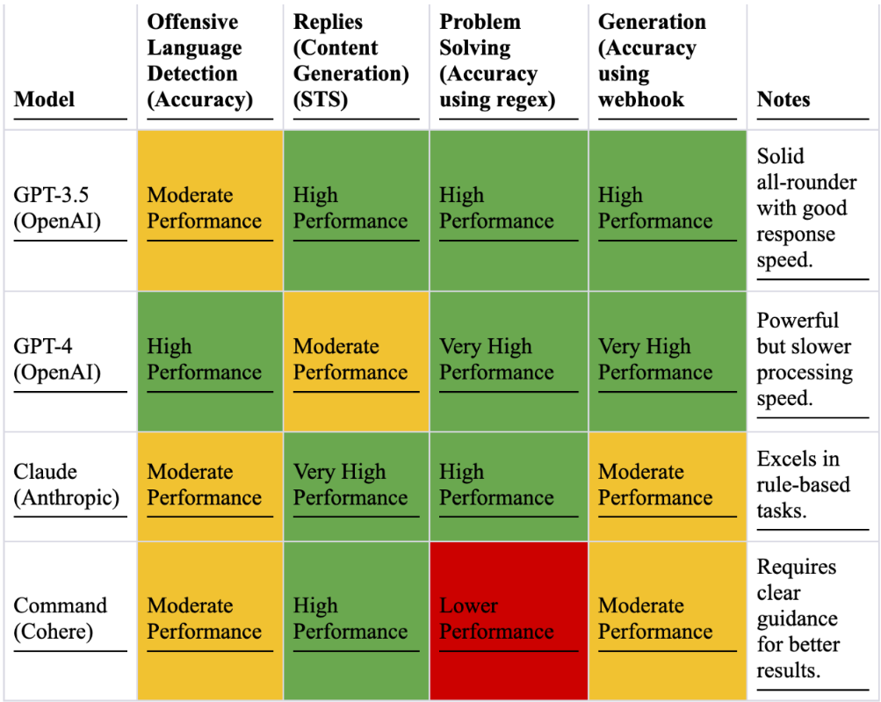
Model comparison – PUBLIC Data
More information: https://www.activeloop.ai/resources/how-to-compare-large-language-models-gpt-4-3-5-vs-anthropic-claude-vs-cohere/

Slide 5
Whisper models
Speech Recognition
Whisper models can be used on OpenAI or on Azure AI service. It is preferable to use Whisper models on Azure AI service rather than in the OpenAI service except when:
Quickly transcribing audio files one at a time
Translate audio from other languages into English
Provide a prompt to the model to guide the output
Supported file formats: mp3, mp4, mpweg, mpga, m4a, wav, and webm
Use Cases to explore at DSI:
Real-time transcriptions, captions, and subtitles for audio and video.
Transcriptions, captions, and subtitles for prerecorded audio and video: a lot of teams have recorded videos on their portals
Transcript of phone call recordings and analytics such as call summary, sentiment, key topics, and custom insights: can be used by sales reps when they speak with physicians
Transcript of meeting recordings and analytics such as meeting summary, meeting chapters, and action item extraction: can be used across the organizations to improve productivity
Real-time text entry and document generation through voice dictation
Translating live audio or pre- recorded audios from one language to another: helps connect better with colleagues across the globe
For more info:
https://learn.microsoft.com/en-us/azure/ai-services/speech-service/whisper-overview

